Slide 1

Object patterns
Chapter 6 of The Principles of Object-Oriented JavaScript
تطبيقات البرمجة الهدفية
العارف عبد الباسط أبو شعالة
1822294

Slide 2
Table of content
Private and Privileged Members.
The Module Pattern.
Closure
Private members for constructors
Mixins
Scope-safe constructors

Slide 3
Introduction
JavaScript has many patterns for creating objects, You can define your own custom types or your own generic objects whenever you want,You can use inheritance to share behavior between objects,
or you can use mixins.
Now let’s understand Object patterns in javascript more.

Slide 4
01
Private and privileged members

Slide 5

Private and Privileged Members.
All object properties in JavaScript are public.
However, there are many ways of hiding data that don’t rely on convention ways and are therefore more reliable in preventing the changing of private information.

Slide 6
02
The module pattern

Slide 7
The Module Pattern
It is a commonly used Design Pattern which is used to wrap a set of variables and functions together in a single scope.
The basic approach is to use an immediately invoked function expression (IIFE) that returns an object.

Slide 8
Immediately invoked function expression (IIFE)
An IIFE is a javascript function expression that runs as soon as it is defined.
Note:All objects defined within the IIFE have access to the same local variables.
Methods that access private data in this way are called privileged methods

Slide 9
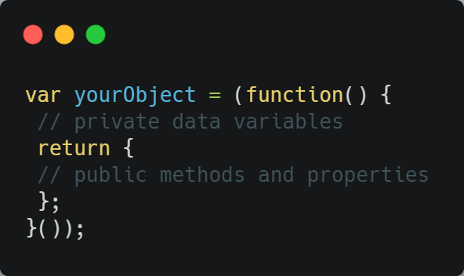
IIFE example
the function exists for just a moment, is executed, and then is destroyed
Note the Extra parentheses at the end of the function

Slide 10
03
Closure

Slide 11
Closure
Closures are functions that access data outside their own scope.
A closure gives you access to an outer function’s scope from an inner function.
Closures are created every time a function is created, at function creation time.

Slide 12
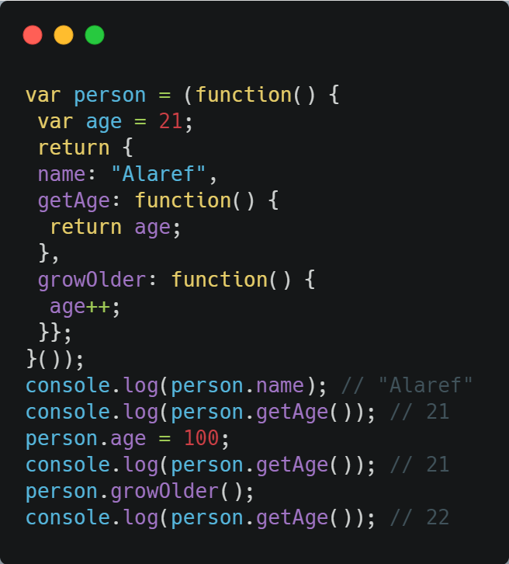
Closure
Private Property
The difference with the module function is that the variables are declared within the IIFE, and a function that is also declared inside the IIFE accesses those variables. For example:

Slide 13
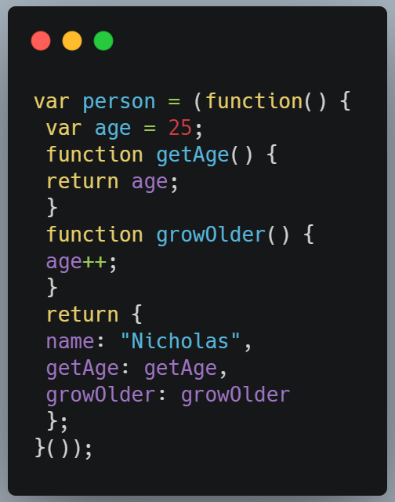
module pattern
There is a variation of the module pattern called the revealing module pattern, which arranges all variables and methods at the top of the IIFE and simply assigns them to the returned object. You can write the previous example using the revealing module pattern as follows:

Slide 14
04
Private Members for Constructor

Slide 15
Private Members for Constructors
Is there a way for defining custom types that also require their own private properties?

Slide 16
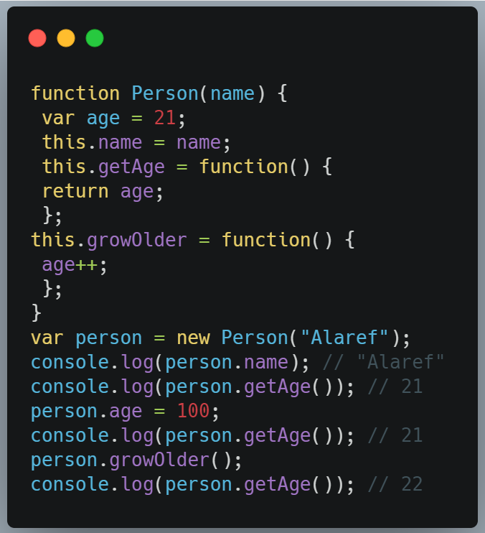
Private Members for Constructors
You can use a pattern that’s similar to the module pattern inside the constructor to create instance-specific private data. For example:

Slide 17
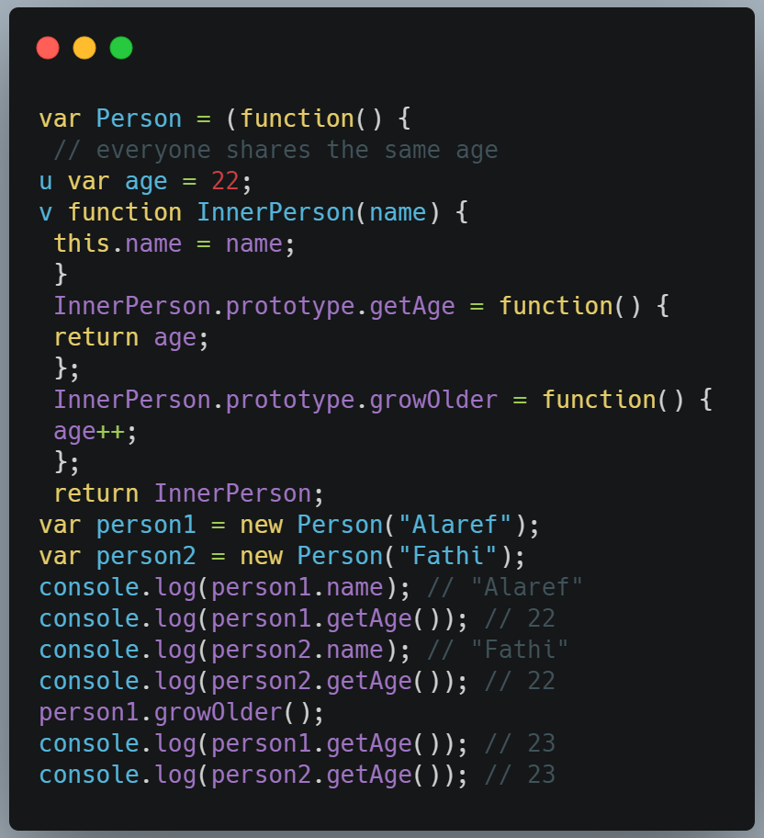
As discussed in Chapter 4, placing methods on an object instance is less efficient than doing so on the prototype, but this is the only approach possible when you want private, instance-specific data. If you want private data to be shared across all instances (as if it were on the prototype),
you can use a hybrid approach that looks like the module pattern but uses a constructor:

Slide 18
04
Mixins

Slide 19
Mixins
Mixins occur when one object acquires the properties of another without modifying the prototype chain.
The first object (a receiver) actually receives the properties of the second object (the supplier) by copying those properties directly.
You can also define mixins is a class containing methods that can be used by other classes without a need to inherit from it.

Slide 20
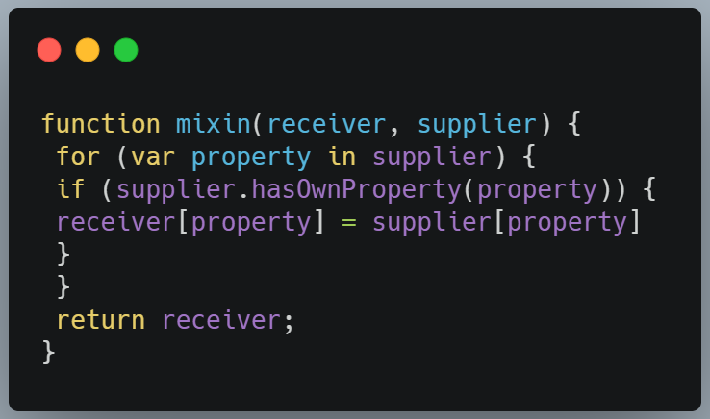
Mixins
you create mixins using a function such as this:
The mixin() function accepts two arguments: the receiver and the supplier. The goal of the function is to copy all enumerable properties from the supplier onto the receiver

Slide 21
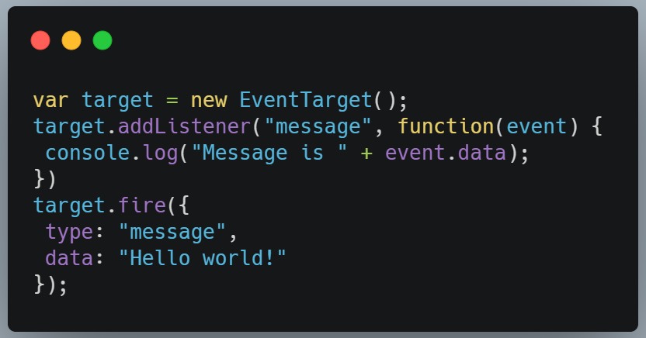
Mixins
You can use instances of EventTarget like this:

Slide 22
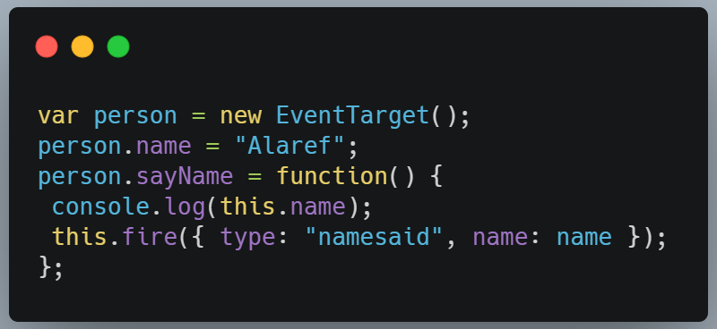
Mixins
If you want to have a different type of object that also supports events, you have a few options. First, you can create a new instance of EventTarget and then add on the properties that you want:
In this code, a new variable called person is created as an instance of EventTarget, and then the person-related properties are added. Unfortunately, this means that person is actually an instance of EventTarget instead of Object or a custom type

Slide 23
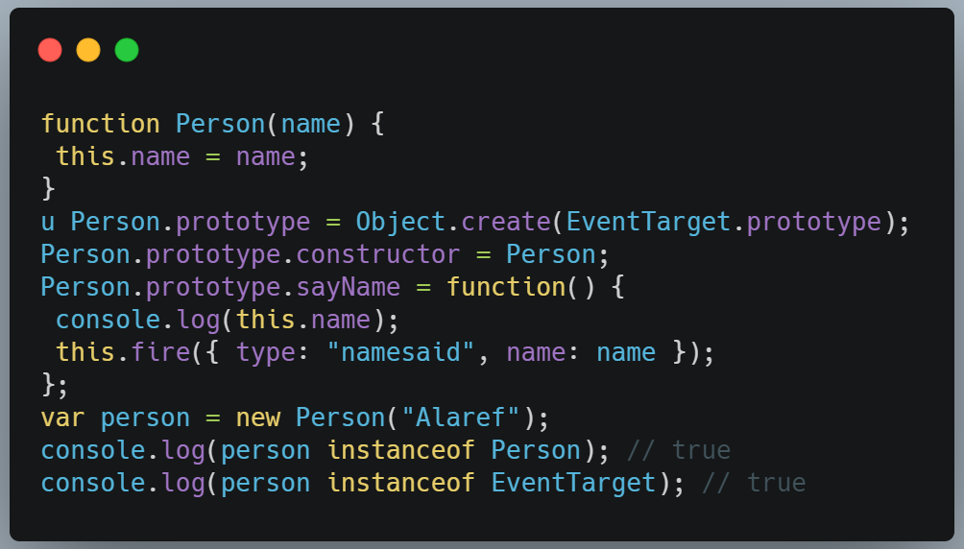
A second way to solve this problem is to use pseudoclassical inheritance:
there is a new Person type that inherits from EventTarget. You can add any further methods you need to Person’s prototype afterward.

Slide 24
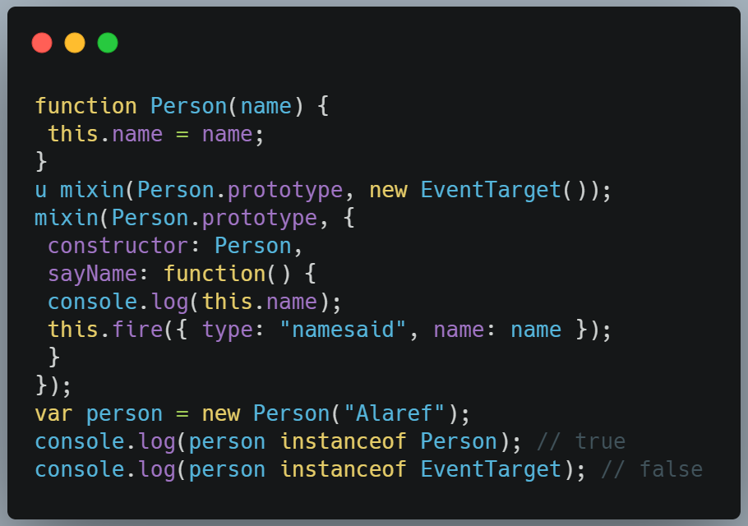
By using a mixin instead, you can reduce the amount of code necessary to assign those new properties to the prototype:
Here, Person.prototype is mixed in with a new instance of EventTarget u to get the event behavior. Then, Person.prototype is mixed in with constructor and sayName() to complete the composition of the prototype. Instances of Person are not instances of EventTarget in this example because there is no inheritance.

Slide 25
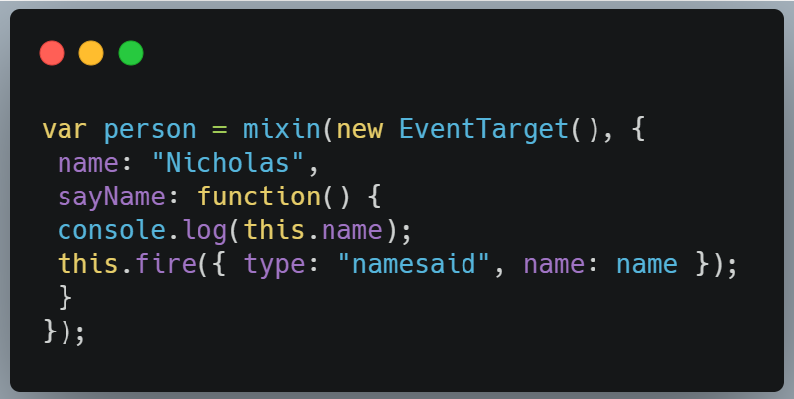
you might decide that while you do want to use an object’s properties, you don’t want a constructor of pseudoclassical inheritance at all. In that case, you can use a mixin directly when you create your new object:
In this example, a new instance of EventTarget is mixed in with some new properties to create the person object without affecting person’s prototype chain.

Slide 26
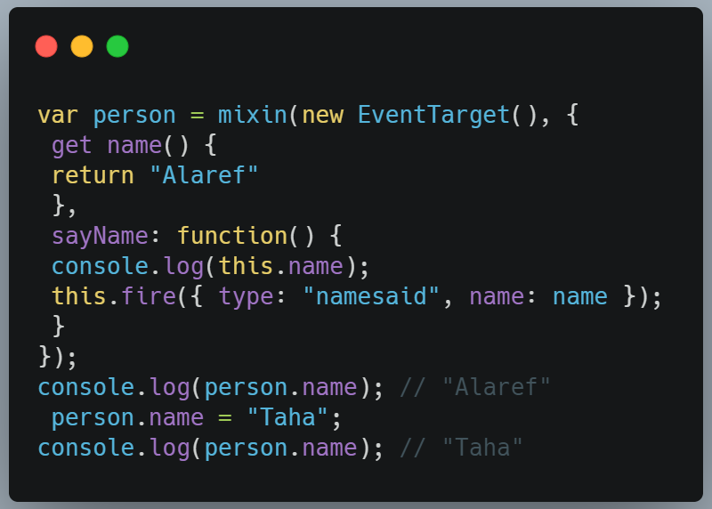
One thing to keep in mind about using mixins in this way is that accessor properties on the supplier become data properties on the receiver, which means you can overwrite them if you’re not careful. That’s because the receiver properties are being created by assignment rather than by Object.defineProperty(), meaning the current value of the supplier property is read and then assigned to a property of the same name on the receiver. For example:
accessor property

Slide 27
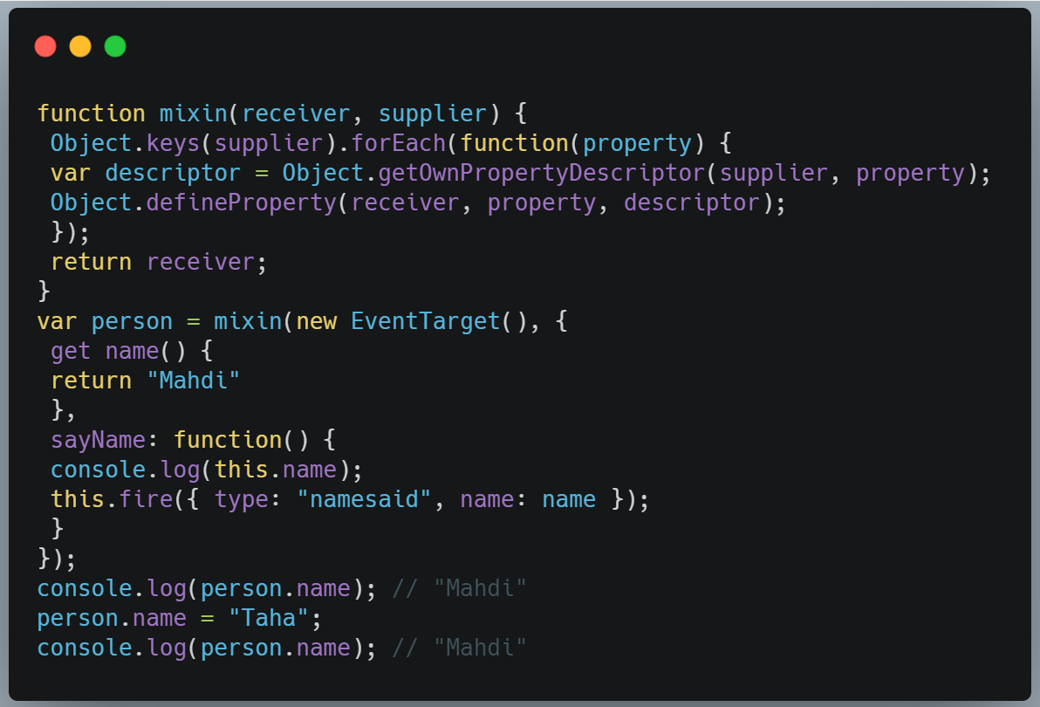
This version of mixin() uses Object.keys() u to get an array of all enumerable own properties on supplier. The forEach() method is used to iterate over those properties

Slide 28
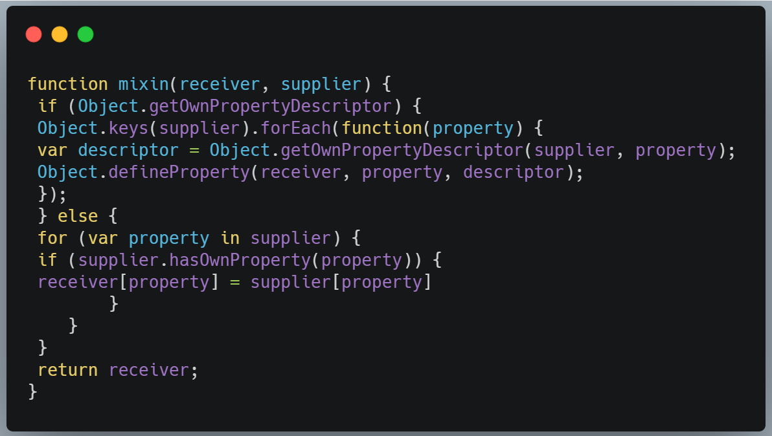
this version of mixin() works only in ECMAScript 5 JavaScript engines. If your code needs to work for older engines, you should combine the two mixin() approaches into a single function:
Here, mixin() checks whether Object.getOwnPropertyDescriptor() u exists to determine whether the JavaScript engine supports ECMAScript 5. If so, it goes on to use the ECMAScript 5 version. Otherwise, the ECMAScript 3 version is used

Slide 29
05
Scope-Safe Constructors

Slide 30
Scope-Safe Constructors
Because all constructors are just functions, you can call them without using the new operator and therefore affect the value of this. Doing so can yield unexpected results, as this ends up coerced to the global object in nonstrict mode, or the constructor throws an error in strict mode.

Slide 31
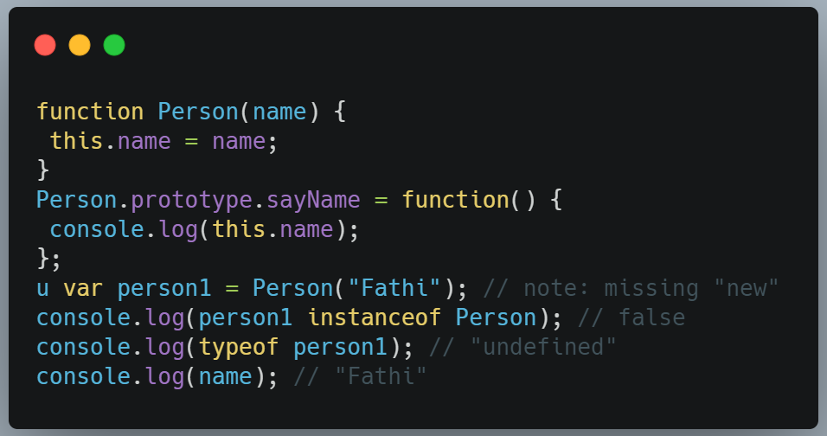
Scope-Safe Constructors
. In Chapter 4, you encountered this example:
In this case, name is created as a global variable because the Person constructor is called without new.
Many built-in constructors, such as Array and RegExp, also work without new because they are written to be scope safe.

Slide 32
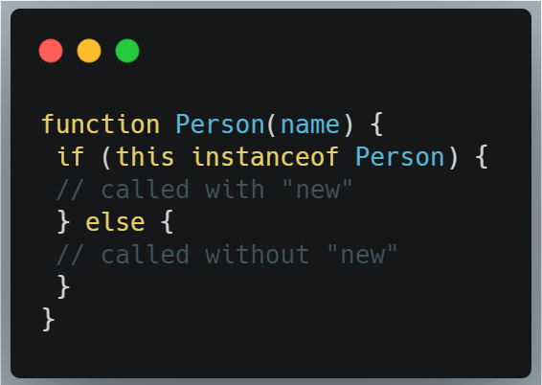
When new is called with a function, the newly created object represented by this is already an instance of the custom type represented by the constructor. So you can use instanceof to determine whether new was used in the function call:
Using a pattern like this lets you control what a function does based on whether it’s called with new or without. You may want to treat each circumstance differently

Slide 33
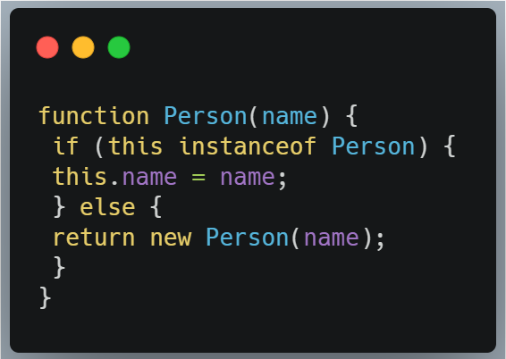
. A scope-safe version of Person looks like this
For this constructor, the name property is assigned as always when new is used. If new isn’t used, the constructor is called recursively via new to create a proper instance of the object.

Slide 34
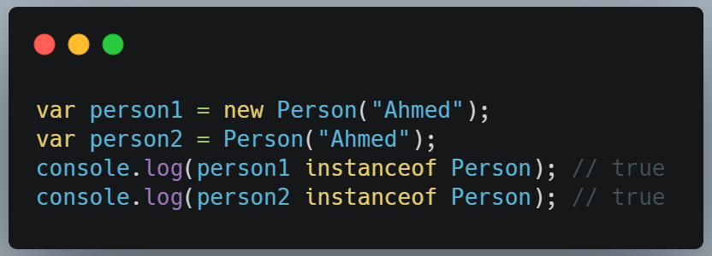
In this way, the following are equivalent:
Creating new objects without using the new operator is becoming more common as an effort to curb errors caused by omitting new. JavaScript itself has several reference types with scope-safe constructors, such as Object, Array, RegExp, and Error.

Slide 35
Thanks
العارف عبد الباسط أبو شعالة

